Slide 1
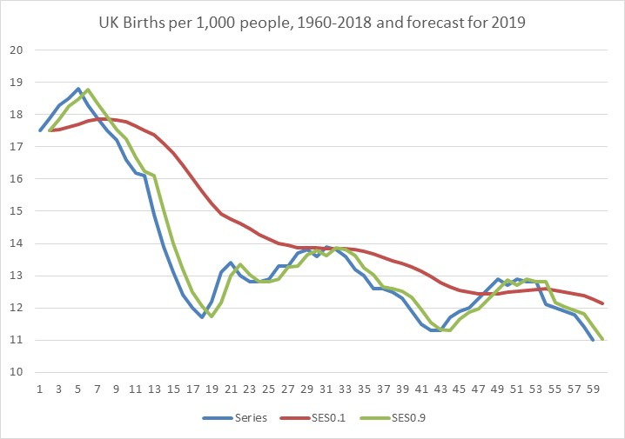
Time series data - Short and medium term forecasts
Exponential smoothing?
Handling errors?
Forecasting?
The aim of this chapter is to provide the reader with a set of tools which can be used in the context of time series analysis and extrapolation.
Handling seasonality using exponential smoothing?

Slide 2
Introduction
Short-term and medium-term forecasting methods require understanding of relatively simple and intuitive concepts, such as moving averages and exponential smoothing.
Part 1 Moving averages
After we introduced a concept of a moving average, we will learn how to use this concept as a short-term forecasting technique. If we wanted to use the same technique for medium-term forecasts, then certain modifications are needed, and we will introduce double moving averages to explain how to achieve this.
Part 2 Exponential smoothing
As a more sophisticated alternative to moving averages, we will introduce exponential smoothing. This method can also be used as a short-term and a medium-term approach to forecasting. We will explain how both types of forecasts are executed using this technique.

Slide 3
Learning objectives
On completing this unit, you should be able to:
Understand moving averages.
Be able to forecast using single and double moving averages.
Understand exponential smoothing.
Be able to forecast using single and double exponential smoothing.
Calculate a measure of error for the model fit to the data set.
Construct a prediction interval.
Produce seasonal short to medium range forecasts.
Be able to apply Holt-Winters method to seasonal mid-range forecasts.
Solve problems using the Microsoft Excel and SPSS.

Slide 4
Part 2 Exponential smoothing (1/7)
In order to introduce the exponential smoothing method, we need to assume that one of the ways to think about observations in a time series is to say that the previous value in the series (y_{t-1}), plus some error element (e_{t}), is the best predictor of the current value ( ). This can be expressed by equation (11.10).
Remember equation (10.1) from the previous chapter? It states that Y = T + R, which is a similar principle we are using here, only we are now using the previous value y_{t-1} instead of the trend value T.
When the value of y_{t-1} changes over time by going upwards or downwards (non-stationary time series), then more recent observations are more important than older observations and they should be appropriately weighted. Simple exponential smoothing is a forecasting method that applies unequal weights to the time series data, i.e. we have a power to decide if older or more recent data should gain more weight in deciding about the future. Let’s explain how we are going to get to this formula.

Slide 5
Part 2 Exponential smoothing (2/7)
We’ll modify equation (11.10) and state that every new forecast is equal to the old forecast plus an adjustment for the error that occurred in the last forecast i.e. e_{t-1} = y_{t-1} - F_{t-1}, as presented in equation (11.11).
Where y_{t-1} is the actual result from period t – 1 and F_{t-1} is the forecast result for period t - 1.
Let us now assume that the error element, i.e. (y_{t-1} - F_{t-1}) is zero. In this case the current forecast is the same as the previous forecast. However, if it is not zero, we can take the full impact of the error e_{t}, or just a fraction of the error. If we are going to take a fraction of the error, then this means that we need to multiply it with the value somewhere between 0 and 1. This is done using equation (11.12).
We use letter α (alpha) to describe the fraction, and the word ‘fraction’ implies that α takes values between zero and one.

Slide 6

Part 2 Exponential smoothing (3/7)
If α = 0, then current forecast is the same as the previous one. If α = 1, then current forecast is also the same as the previous one, plus the full amount of the deviation between the previous actual and forecasted value.
Why a fraction of an error? If every current forecast/observation depends on the previous one and this one depends on the one before etc., then all the previous errors are in fact embedded in every current observation/forecast. By taking a fraction of error, we are in fact discounting the influence that every previous observation and its associated error has on current observations/forecasts.
The origins of equation (11.11) and (11.12) can be found in Brown’s single exponential smoothing method. However, the original Brown’s formula states that:
Note that Brown uses y_{t} rather than y_{t-1}. This effectively means every current smoothed value in Brown’s formula is the future forecast value in our formula. If we use the original smoothing equation by Brown, then we have to remember that (see equations (11.11) and (11.12)).

Slide 7
Part 2 Exponential smoothing (4/7)
This is the same principle as with moving averages, where we said that a moving average for an interval can be used as either a central value for the interval, or as a forecast for the time period that follows the interval.
Equation (11.12) can also be rewritten as equation (11.14).
Equations (11.12) and (11.14) are identical and it is a matter of preference which one to use. They both provide identical forecasts based on smoothed approximations of the original time series.
This approach to forecasting is based on the single exponential smoothing method, and we will explain shortly why the word ‘exponential’ is used.

Slide 8


Part 2 Exponential smoothing (5/7)
We implied that the smaller the α (i.e. the closer α to zero), the smoother and more horizontal the series of newly calculated values is going to be. Conversely, the larger the α (i.e. the closer α to one), the more impact the deviations have and potentially the more dynamic the fitted series is. When α=1, the smoothed values are identical to the original values, i.e. no smoothing is taking place.
There is a connection between Brown’s formula, i.e. equation (11.13) and the moving averages concept. You will recall from the section on moving averages that we’ve said that:
The above equation can be written as:
This looks very much like equation (11.12).

Slide 9


Part 2 Exponential smoothing (6/7)
In this case, it looks as if
Although this is not strictly true (see the text just below), the similarity between moving averages and exponential smoothing remains indicative. This is the reason why exponential smoothing is sometimes called exponentially weighted moving average (EWMA) method.
The smoothing constant (α) and the number of elements in the interval for calculating moving averages are in fact related. The equation that defines this relationship is given by equation (11.15).
In equation (11.15), M is a number of observations used to calculate the moving average. The formula indicates that the moving average for three observations that we used earlier is equivalent to α = 0.5.
11.15
Equally, α = 0.2 is equivalent to M = 9. So, the smaller the value of the smoothing constant, the more horizontal the series will be, just like in the case when larger number of moving averages is used.

Slide 10
Part 2 Exponential smoothing (7/7)
If we substituted in the formula for exponential smoothing all the previous values from the series, we would see that effectively we are multiplying the newer observations with higher values of α and the older data in the series with the smaller values of α.
By doing this we are in effect assigning a higher importance to the more recent observations.
As we move further in the past, the value of α drops exponentially. This is the reason why we call it exponential smoothing.
Every value in the time series is affected by all those that precede it, but the relative weight (importance) of these preceding values declines exponentially the further we go in the past.

Slide 11
Forecasting with Exponential smoothing
When discussing moving averages, we learned that, depending where we place the moving average value, it can be considered either just a simple moving average value (if it is centred or at the end of the moving average interval) or a forecast obtained using a moving average (if it is placed one period after the moving average interval). The example we can use is if we have 3MA value and we place it in the third period, then we are simply implying that this value is a moving average of this interval of three observations. If, on the other hand, we put it in the fourth period position, then we imply that this moving average value is the forecast for the next period, based on the previous three. The same principle is valid when using exponential smoothing. If you remember that the past smoothed value can also be used as a forecast, then hopefully there is no confusion:

Slide 12
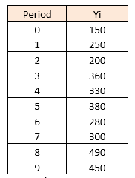




Example 11.5 (1/2)
As an example, let’s use a short time series to demonstrate how to use exponential smoothing to create forecasts using Brown’s exponential smoothing method. The time series is given in Table 11.2:
To start the smoothing process, we must make a choice for the value of the smoothing constant α and the initial estimate of . The value of is needed to determine the smoothed statistic for .
In this example, we have chosen α = 0.3 and

Slide 13
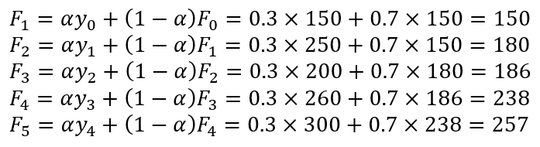
Example 11.5 (2/2)
Exponentially smoothed values are calculated using equation (11.14):

Slide 14
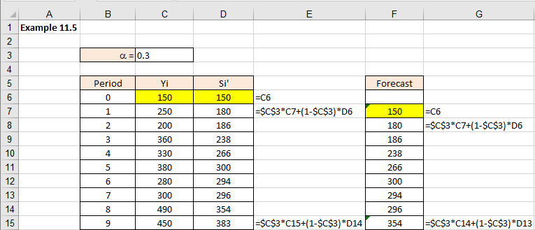
Example 11.5 – Excel
Figure 11.31
As was the case with moving averages, in order to forecast one value in the future, we need to shift the exponential smoothing calculations by one period ahead. The last exponentially smoothed value will in effect become a forecast for the following period. That is what we did in column F in Figure 11.31.

Slide 15
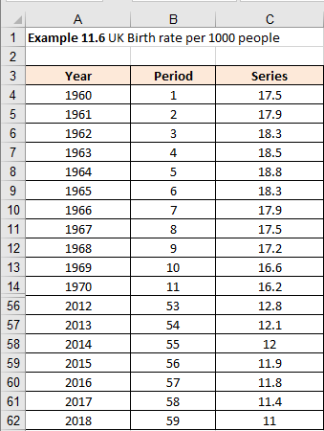
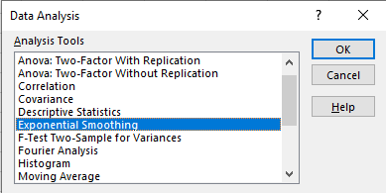
Example 11.6 – Excel (1/4)
We will use data from Example 11.4 to create a new Example 11.6 that demonstrates the use of exponential smoothing via the Excel Data Analysis method. Figure 11.31 illustrates the data in Excel.
Select Data > Select Data Analysis > Select Exponential Smoothing
Click OK to access the Exponential Smoothing menu.

Slide 16
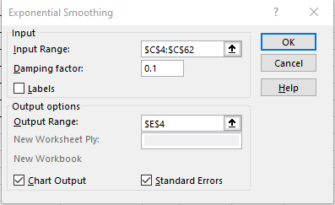
Example 11.6 – Excel (2/4)
WARNING: Excel uses the expression “Damping factor”, rather than smoothing constant, or α. Damping factor is defined as (1 - α). In other words, if you want α to be 0.3, you must specify in Excel the value of the damping factor as 0.7.
Input the menu inputs as illustrated in Figure 11.33 and click OK.

Slide 17
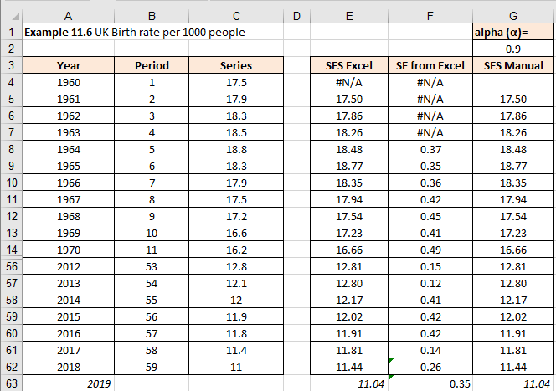
Example 11.6 – Excel (3/4)
In our case α=0.9, so we had to enter 0.1 in the dialogue box in Figure 11.33. If you wanted the Chart Output and the Standard Errors (more about that later), then you can tick the two boxes at the bottom.
The final output is as in Figure 11.34 (we are again hiding rows 15:55).

Slide 18
Example 11.6 – Excel (4/4)
The values in column E were produced by the Excel app, and the values in column G are reproduced manually converting equation (11.13) into Excel formula.
From Figure 11.34, we observe the forecast for time point 2019 is 11.04.
As we can see, the only difference between the formulae from column E (Excel calculation) and column F (manual calculation) is that manual calculation uses alpha (α=0.9) and Excel uses Dumping factor (1 - α = 1 - 0.9 = 0.1). Data Analysis > Exponential Smoothing solution illustrated in Figure 11.35 method always ignores the first observation and produces exponential smoothing from the second observation.
It also cuts short with the exponential smoothing values, as the last exponentially smoothed value corresponds with the last observation in the series. You can easily extend the last cell one period in the future, which is what we did.

Slide 19
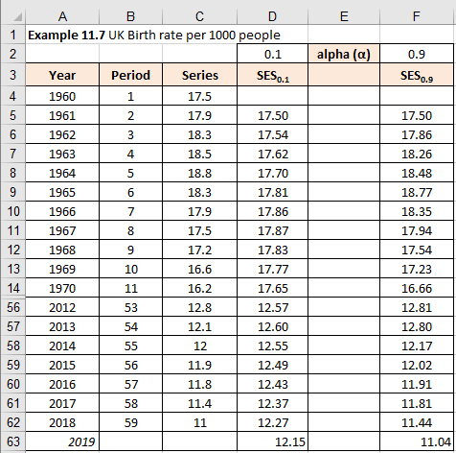
Example 11.7 – Excel (1/2)
We are using the same data set as in Example 11.6, and the two different alpha values used are 0.1 and 0.9. Rows 15:55 are hidden in Figure 11.35.
Initial value SES₂ = Y₁
F₂ = SES₂ = S₁’
Forecast F_{t}
F_{t} = α y_{t-1} + (1 - α) F_{t-1} (11.14)
From Figure 11.35, we observe the forecast for time point 2019 given two values of α = 0.1, 0.9 are 12.15 and 11.04 respectively.

Slide 20
Example 11.7 – Excel (2/2)
The results are charted in the graph in Figure 11.36. As we can see the ex-post forecasts for α=0.9 are following more closely the original time series, whilst the ex-post forecasts for α=0.1 give us much smoother line, as expected.
Figure 11.36

Slide 21
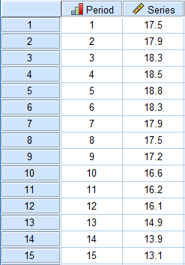
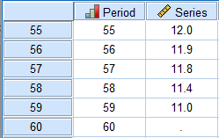
Example 11.7 – SPSS (1/16)
Enter data into SPSS – first 15 data values shown in Figure 11.37
The last data points are illustrated in Figure 11.38 including the time point 60 for the 2019 forecast.

Slide 22
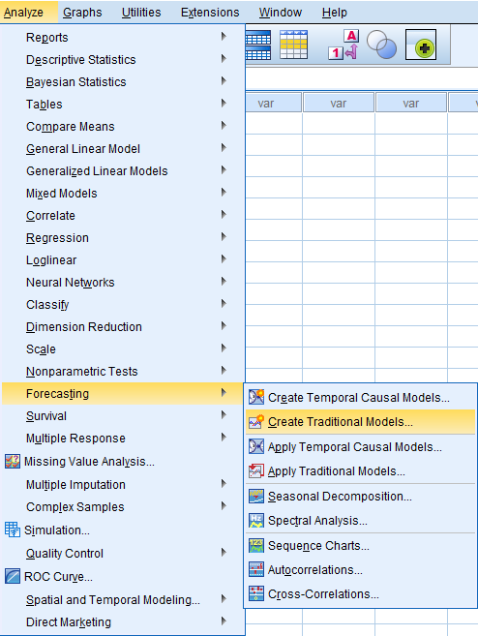
Example 11.7 – SPSS (2/16)
Analyze > Forecasting > Create Traditional Models

Slide 23
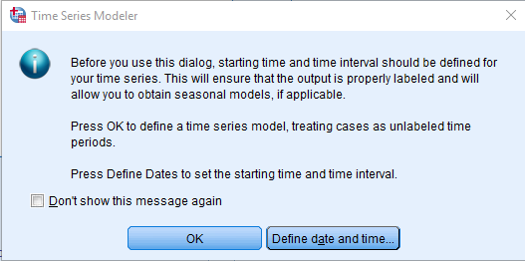
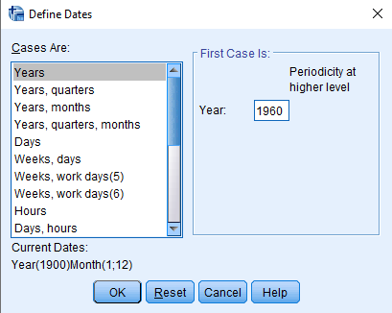
Example 11.7 – SPSS (3/16)
Define date by clicking on Define date and time (year, starting 1960)
Click OK

Slide 24
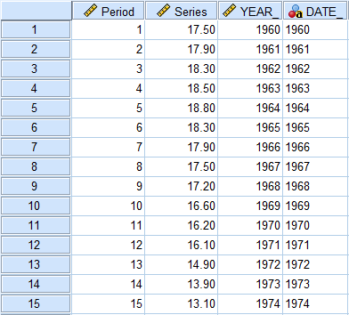
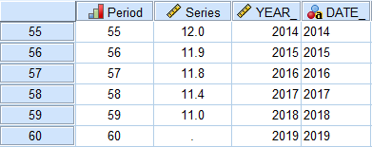
Example 11.7 – SPSS (4/16)

Slide 25
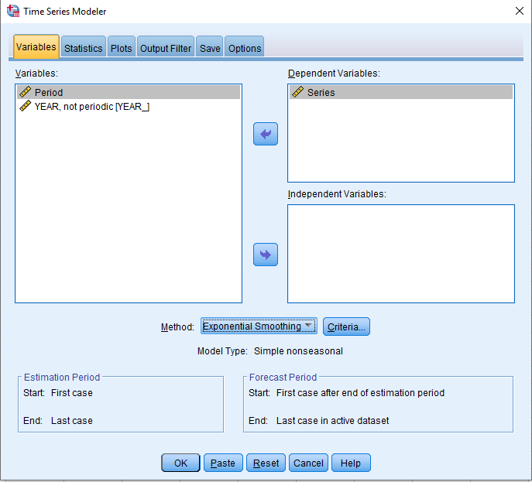
Example 11.7 – SPSS (5/16)
Now run the analysis
Analyze > Forecasting > Create Traditional Models
Transfer variable Series into the Dependent Variables box
Select Method: Exponential Smoothing

Slide 26
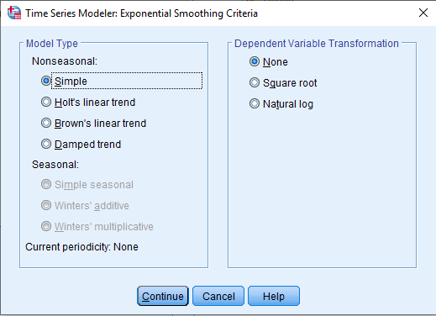
Example 11.7 – SPSS (6/16)
Click on Criteria button and choose Model Type – Nonseasonal – Simple
Click Continue

Slide 27
Example 11.7 – SPSS (7/16)
Select Statistics tab
Figure 11.46

Slide 28
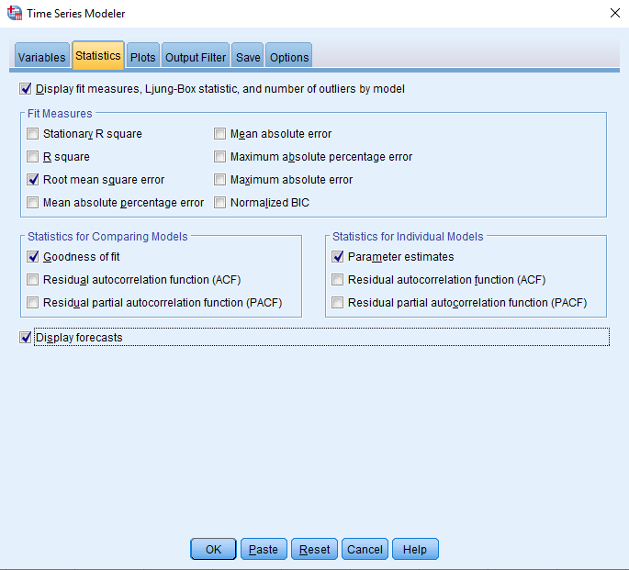
Example 11.7 – SPSS (8/16)
Choose options selected in Figure 11.47
Figure 11.47

Slide 29
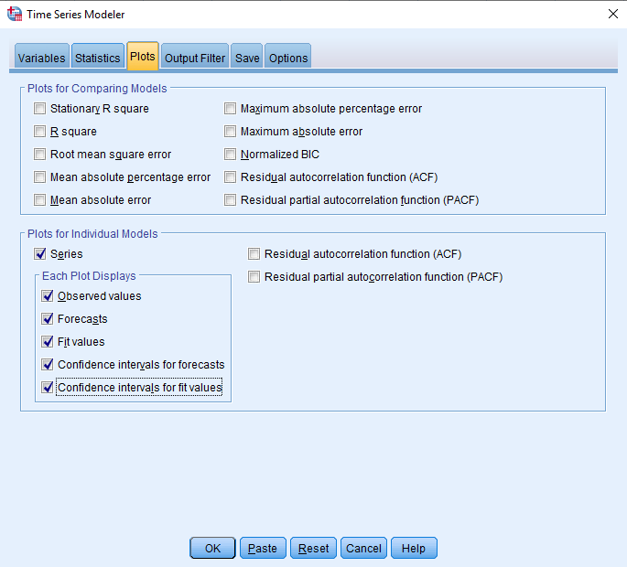
Example 11.7 – SPSS (9/16)
Select Plots tab and choose options selected in Figure 11.48
Figure 11.48

Slide 30
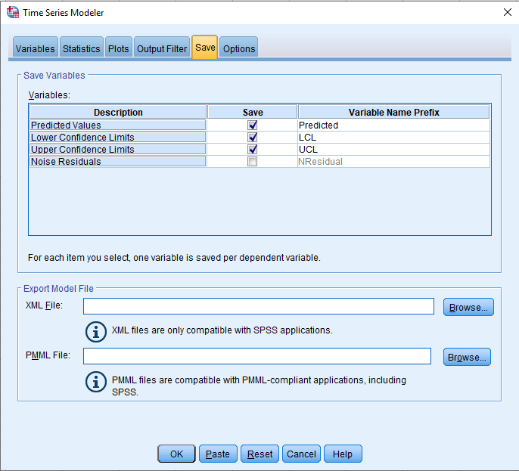
Example 11.7 – SPSS (10/16)
Select Save tab
Figure 11.49

Slide 31
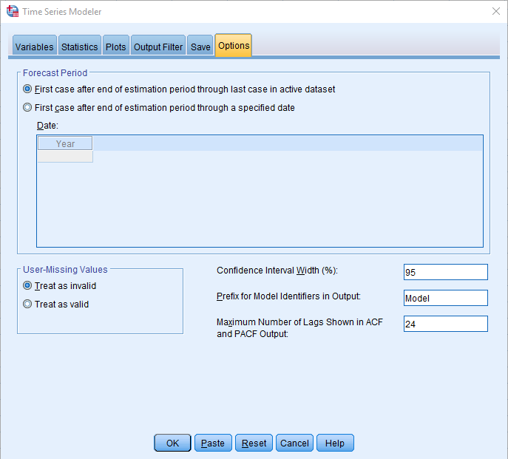
Example 11.7 – SPSS (11/16)
Select Options tab and choose Forecast Period: First case after end of estimation period through last case in active data set (2019) as illustrated in Figure 11.50
Click OK
Figure 11.50

Slide 32
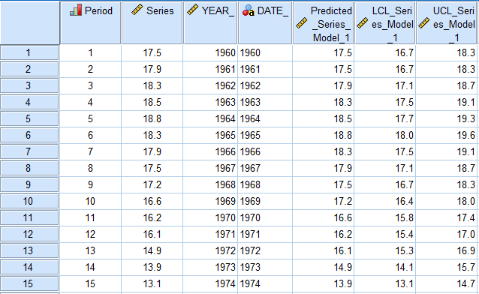
Example 11.7 – SPSS (12/16)
SPSS data file
Figures 11.51 and 11.52 illustrates the SPSS data file (only first 15 rows shown)
Figure 11.51

Slide 33
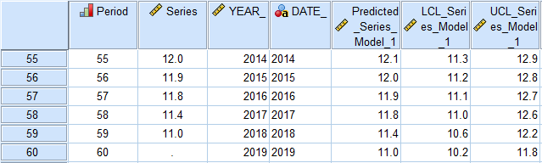
Example 11.7 – SPSS (13/16)
Figure 11.52

Slide 34
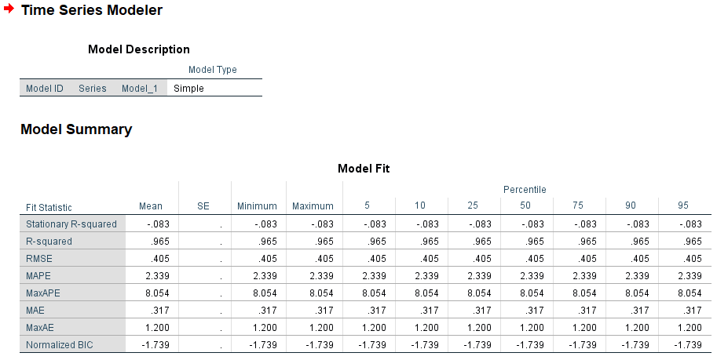
Example 11.7 – SPSS (14/16)
SPSS output
SPSS will come up with the following printout
Figure 11.53

Slide 35
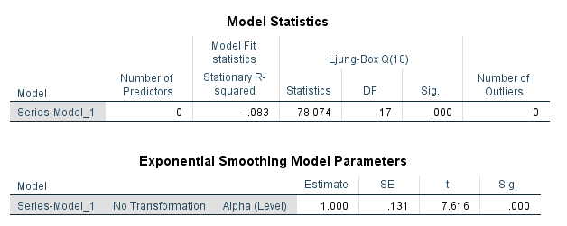
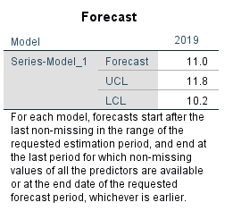
Example 11.7 – SPSS (15/16)
Figure 11.54
Figure 11.55
From Figure 11.55, we observe the predicted (or forecast) value for time point 2020 is 11.0. The forecast values illustrated in Figure 11.55 are comparable to those calculated by Excel (11.04) and shown in Figure 11.35. However, you will notice that SPSS did not ask us to determine the value of alpha. It optimized it to find the smallest RMS.

Slide 36
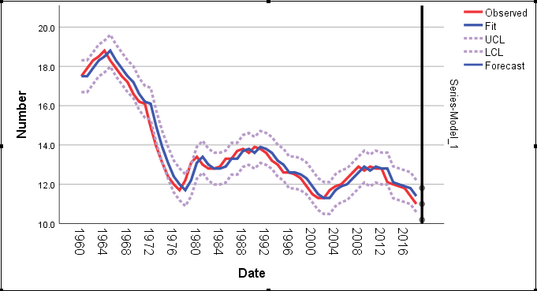
Example 11.7 – SPSS (16/16)
Figure 11.56 illustrates a graph plot for the observed date values, fitted predicted values from the smoothing model, lower and upper confidence limits, and the forecasted values for time point 60.
Like single moving averages, simple exponential smoothing as a forecasting method can produce forecasts only one period ahead. To have longer, i.e. mid-range forecasts, a modification is needed
Figure 11.56

Slide 37
Mid-range forecasting with exponential smoothing (1/2)
In order to use simple exponential smoothing beyond just a single forecast, we must add a few simple equations. Like equations (11.5) – (11.8), we need to introduce double exponential smoothing values (DES) and the related parameters a_{t} and b_{t} that will be used to produce linear forecasts beyond just one future value. To apply the analogy with the double moving averages, we can say that double exponential smoothing values are exponentially smoothed values of the exponentially smoothed values. Single exponential smoothing (SES) equation (11.14) could be applied to construct double exponentially smoothed (DES) values:
We are using a single apostrophe (S’) to symbolize single (SES) and a double apostrophe (S”) to symbolize double exponentially smoothed (DES) values. Again, using the analogy with the DMA forecasting method, double exponential smoothing (DES) forecasting method is:

Slide 38

Mid-range forecasting with exponential smoothing (2/2)
The only difference is that the coefficients a_{t} and b_{t} are calculated as:

Slide 39
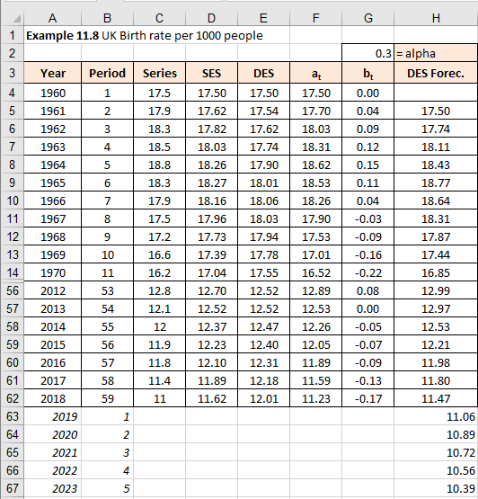
Example 11.8 – Excel (1/2)
In Example 11.4 we produced forecasts using the DMA (Double Moving Average) method. In the following Example 11.8, we will use the same data set and produce forecasts using the DES (Double Exponential Smoothing) method.
Figure 11.57

Slide 40
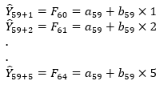
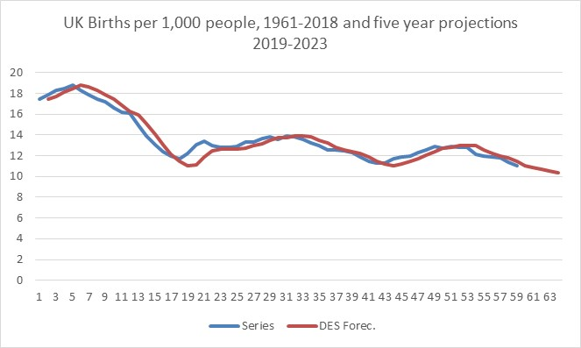
Example 11.8 – Excel (2/2)
As before, the past forecasts, or the DES fit of the existing time series is given in cells H4:H62. However, the future forecasts are given in cells H63:H67 and they were calculated using equation (11.17). Example below shows these calculations:
The chart in Figure 11.58 shows the final result, i.e. the graph of the original time series and its DES forecasts.

Slide 41
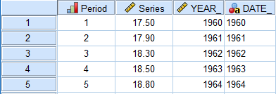
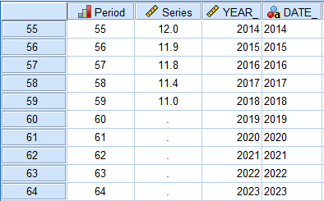
Example 11.8 – SPSS (1/7)
Input data into SPSS and include dates (Figure 11.38 to Figure 11.44 are identical to this implementation) as illustrated in Figures 11.59 and 11.60.
Figure 11.59
Notice the forecast time points are 60 – 64.
Figure 11.60

Slide 42
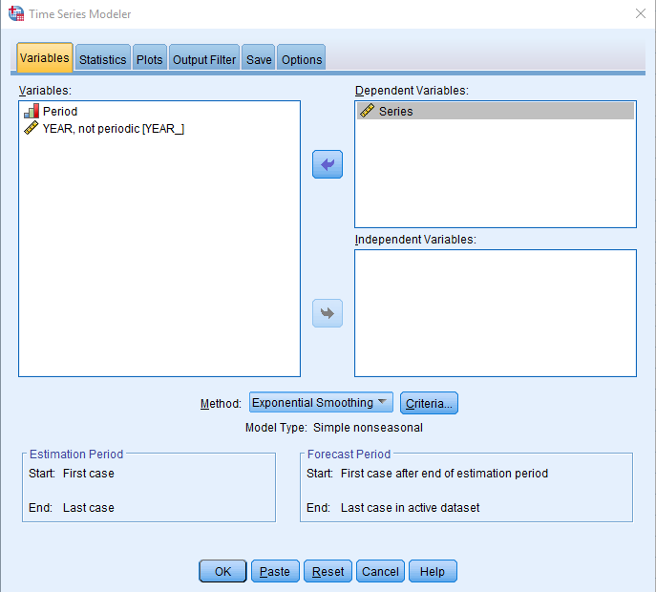
Example 11.8 – SPSS (2/7)
Select Analyze > Forecasting > Create Traditional Models
Transfer Series into Dependent Variables box
Choose Method: Exponential Smoothing
Figure 11.61

Slide 43
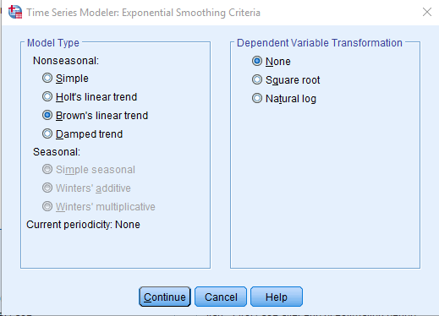
Example 11.8 – SPSS (3/7)
Click on Criteria and select Model Type Nonseasonal: Brown’s linear trend (this is how SPSS refers to the DES method)
Figure 11.62
Click Continue

Slide 44
Example 11.8 – SPSS (4/7)
Figure 11.63

Slide 45
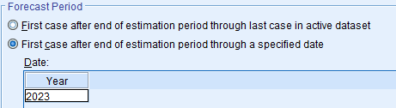
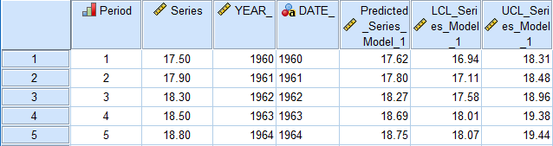
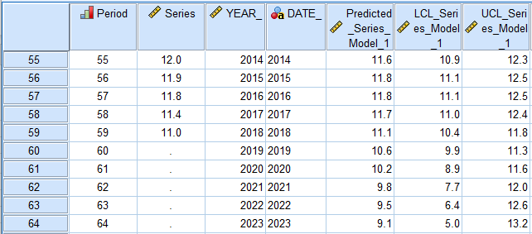
Example 11.8 – SPSS (5/7)
We will not show several other screens as in Figures 11.47-11.50 as they are virtually identical.
Figure 11.64
The result is shown in Figures 11.65 and 11.66, where SPSS added more variables that define this DES, or Brown’s model.

Slide 46

Example 11.8 – SPSS (6/7)
From Figure 11.66, the double exponential smoothing forecasts are 10.6, 10.2, 9.8, 9.5, and 9.1. The values in Figure 11.66 are slightly different from the values in Figure 11.57, which is the Excel version. If you look at SPSS output, you get the following:

Slide 47
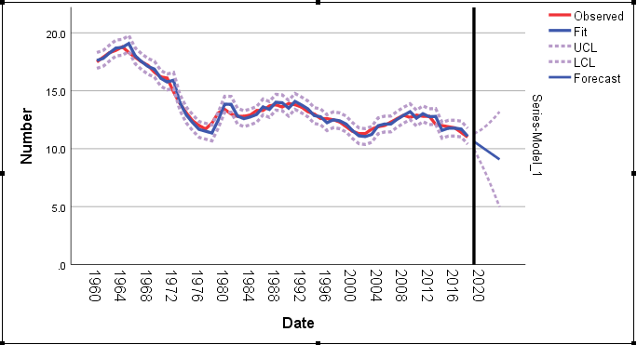
Example 11.8 – SPSS (7/7)
Clearly SPSS used the value of alpha as 0.864, whilst we used 0.9 in Excel. We will learn soon how to optimize the value of alpha to get better forecasts. Finally, Figure 11.68 illustrates the graphical solution
Figure 11.68
There are methods based on exponential smoothing principle that are not necessarily linear, such as the triple exponential smoothing method (TES), but this is beyond the scope of this textbook.

Slide 48
Handling errors for the moving averages or exponential smoothing forecasts
In previous chapter we demonstrated how to use errors to validate the long-term forecasts.
In principle, there is no difference between the long-term and medium-term forecasts.
However, in the context of the mid-term forecasts, we can use errors to help us optimize the forecasts. Excel is very well suited to help us with this.
We will use Example 11.9 and demonstrate how to execute the optimization.

Slide 49
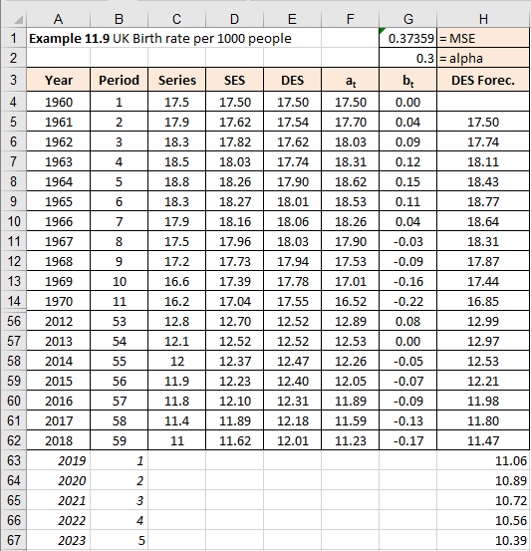
Example 11.9 - Excel (1/6)
Same example as before, and rows 15-55 are again hidden.
Excel solution
All values and cells the same as in Figure 11.58 except MSE in cell G1 is:
G1=SUMXMY2(C5:C62,H5:H62)/COUNT(C5:C61)

Slide 50
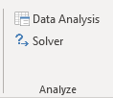
Example 11.9 - Excel (2/6)
As we can see, the only addition to the spreadsheet from Example 11.8 is the cell G1. This is the cell where we introduced the Mean Squared Error (MSE). Rather than adding a new column with errors and then squaring them, adding all up and finding an average (which would be MSE), we used one single formula to calculate the MSE: =SUMXMY2(C5:C62,H5:H62)/COUNT(C5:C62). In our case, the value of MSE is 0.37359, providing the value of alpha is α=0.3. Let’s see how, by manipulating the value of alpha, we can reduce the MSE. To use MSE as a tool for determining the optimal value of the smoothing constant α we need to use a small trick. We will use Excel’s Solver add-in option, which can be found by clicking on Data > Solver menu (see Figure 11.70).
By selecting the Solver option, a dialogue box appears, as in Figure 11.71. As we can see we are aiming (or as Excel would say: Set Objective) to change the values in the cell G1, which is the MSE, and we specified that we want this value to be the smallest possible value, i.e. the minimum. How are we going to do this?
Figure 11.70

Slide 51
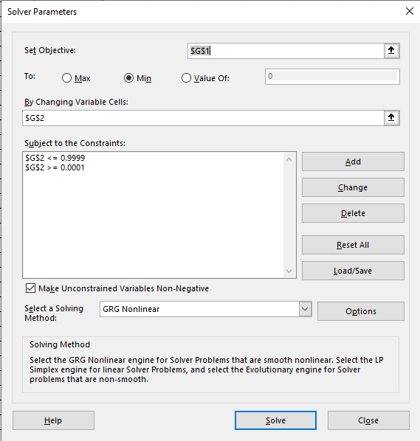
Example 11.9 - Excel (3/6)
We are going to do this by allowing Excel to change all the possible values in G2 (the value of the smoothing constant alpha), until the value in G1 is the minimum.
Figure 11.71 Complete Solver dialogue box ready to optimise the content of the cell G1 (get the minimum value), given the restrictions for cell G2

Slide 52
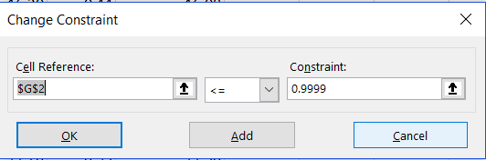
Example 11.9 - Excel (4/6)
In summary, the logic behind the Solver function is to:
Set objective: G1 in our case
By changing Variable Cells: G2 in our case
If we want to impose some restrictions, under the heading of Subject to the Constraints we need to click on the Add button. This triggers another dialogue box, as in Figure 11.72. We need to restrict the value of alpha to a maximum of one and a minimum of zero.
Figure 11.72
Once we have clicked the Solve button, Excel offers additional report sheets (reports on Answers, Sensitivity and Limits), but we will let you explore this independently. The result that Excel offers as the optimum smoothing constant that minimises the MSE is α = 0.85686. This value of alpha yields an MSE of 0.11894, which is a modest improvement over the existing 0.3735 for α=0.3. In other cases, the improvements can be significant.

Slide 53
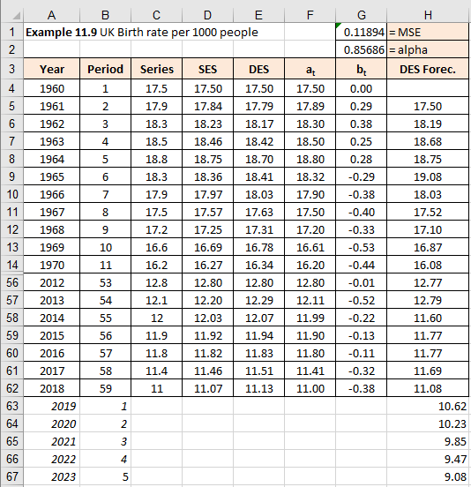
Example 11.9 - Excel (5/6)
Once we have clicked the Solve button, Excel offers additional report sheets (reports on Answers, Sensitivity and Limits), but we will let you explore this independently. The result that Excel offers as the optimum smoothing constant that minimises the MSE is α = 0.85686. This value of alpha yields an MSE of 0.11894, which is a modest improvement over the existing 0.3735 for α=0.3. In other cases, the improvements can be significant.

Slide 54
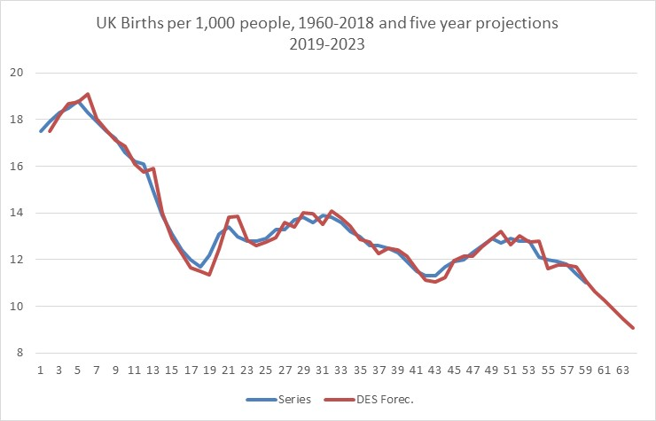
Example 11.9 - Excel (6/6)
If we look at the graph now, it will be visible that our new ex-post forecasts are even closer to the historical values of the time series. Compare the forecast values from Figure 11.73 with the ones from Figure 11.66, which we obtained using SPSS, and you will see that they are identical.
You can also see from Figure 11.67 that SPSS used identical value of alpha that was obtained in our Excel example after using the Solver option.

Slide 55
Prediction interval for short and mid-term forecast (1/2)
In Example 11.3 and 11.6, when we selected moving averages and exponential smoothing respectively, through one of Excel’s Data Analysis apps, one of the dialogue boxes gave us an option to get Standard Errors displayed. As we ignored this option in our explanations, we will briefly repeat the procedure, but this time we will focus on the Standard Error option.
In Example 11.3 in Figure 11.24, column E contained standard errors, as calculated by Excel. The formula that Excel used (the first cell was E12) was =SQRT(SUMXMY2(C8:C12,D8:D12)/5). This is effectively the standard error of the estimate as defined by equation (10.14) from the previous chapter. The only difference is that equation (10.14) has n-2 in the denominator, whilst Excel used number 5. The reason why Excel used number 5 was to match the number of moving averages we selected. This means that the standard error as calculated by Excel is a dynamic standard error. In other words, it is not constant for the whole data set, but it varies as the moving averages change.

Slide 56
Prediction interval for short and mid-term forecast (2/2)
In Example 11.6 in Figure 11.34, column F contains standard errors calculated by Excel, but this time for the exponentially smoothed values. The first value in cell F8 has almost identical formula =SQRT(SUMXMY2(C5:C7,D5:D7)/3). The only difference is that the denominator is 3. It is unclear why Excel uses 3, and it is consistently used regardless of the value of alpha. However, as before, this indicates that the standard error of the estimate is a dynamic value that changes from period to period.

Slide 57
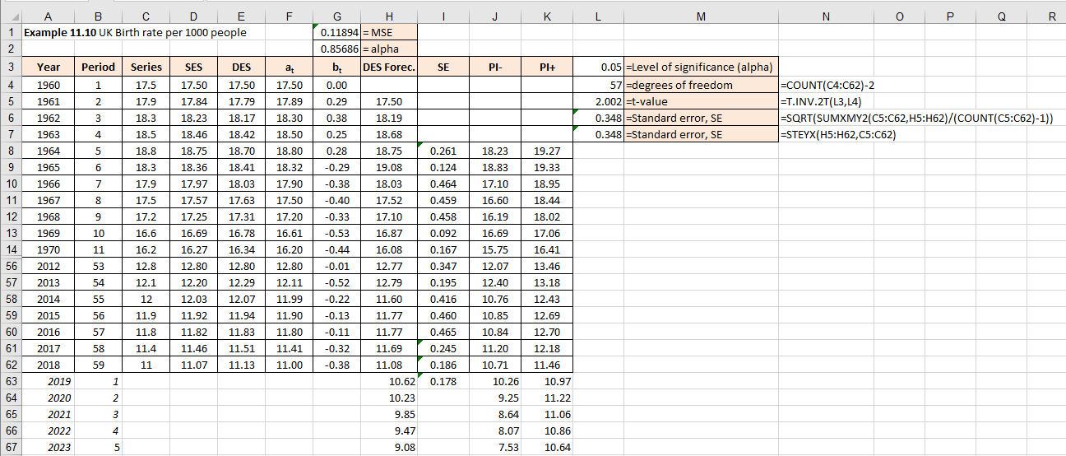
Example 11.10 - Excel (1/3)
We will now use the same data as in Example 11.9 where we optimised the value of alpha using Excel Solver. In Example 11.10 we will extend the calculations and use standard errors to calculate the prediction interval.
Figure 11.75 illustrates the Excel solution (row 15-55 hidden)

Slide 58
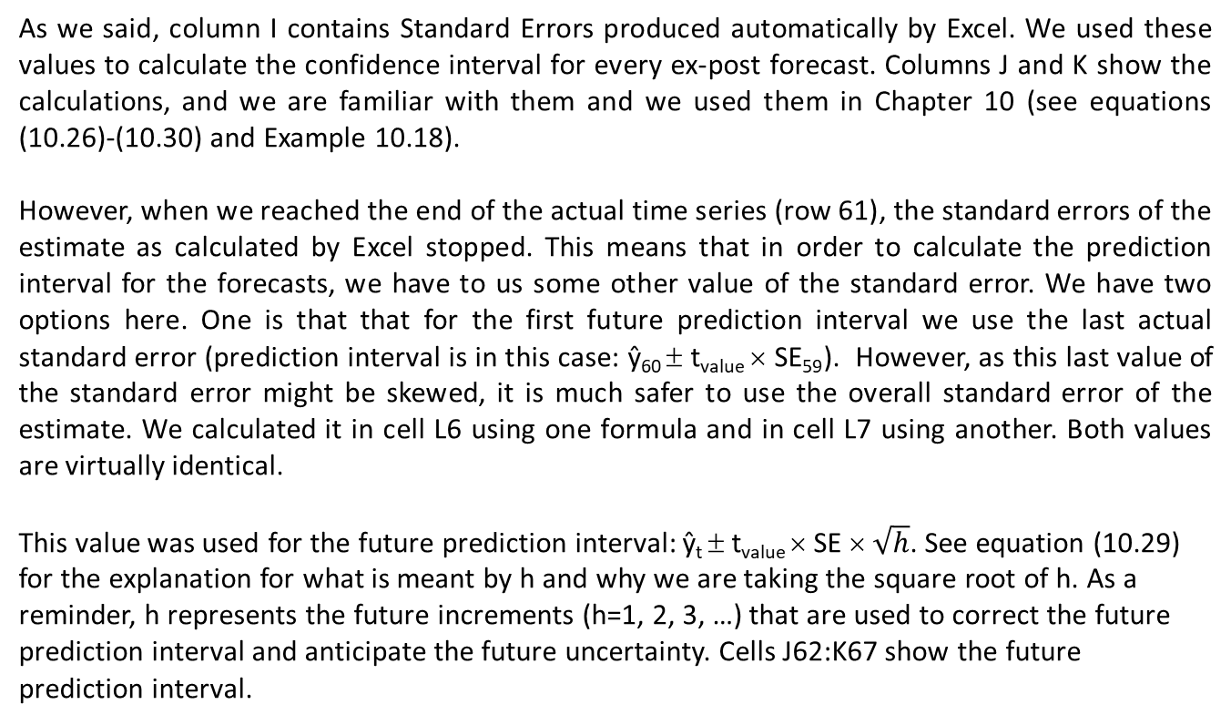
Example 11.10 - Excel (2/3)
As we said, column I contains Standard Errors produced automatically by Excel. We used these values to calculate the confidence interval for every ex-post forecast. Columns J and K show the calculations, and we are familiar with them and we used them in Chapter 10 (see equations (10.26)-(10.30) and Example 10.18).
However, when we reached the end of the actual time series (row 61), the standard errors of the estimate as calculated by Excel stopped. This means that in order to calculate the prediction interval for the forecasts, we have to us some other value of the standard error. We have two options here. One is that that for the first future prediction interval we use the last actual standard error (prediction interval is in this case: ŷ₆₀ ± t_{value} × SE₅₉). However, as this last value of the standard error might be skewed, it is much safer to use the overall standard error of the estimate. We calculated it in cell L6 using one formula and in cell L7 using another. Both values are virtually identical.
This value was used for the future prediction interval: ŷ_{t} ± t_{value} × SE × $\sqrt{h}$. See equation (10.29) for the explanation for what is meant by h and why we are taking the square root of h. As a reminder, h represents the future increments (h=1, 2, 3, …) that are used to correct the future prediction interval and anticipate the future uncertainty. Cells J62:K67 show the future prediction interval.

Slide 59
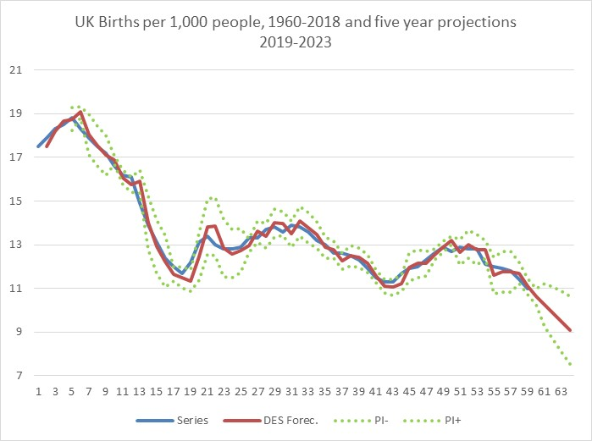
Example 11.10 - Excel (3/3)
As we can see the two dotted lines, symbolizing (DES – t × SE) and (DES + t × SE), follow the red line that represents SES.
The interval is not of consistent width, because it is not calculated on the basis of a single standard error for the whole data set. It is calculated as a dynamic and moving series of standard errors for every rolling 3-period interval.
Figure 11.76
For the final five prediction intervals the standard error is constant, but they are multiplied by the square root of h values (1, 2, 3, ..) for the future prediction intervals.

Slide 60
Example 11.10 - SPSS
There is no need to show how this works in SPSS given that these values were already printed out in Figures 11.65 - 11.66.

Slide 61
Handling seasonality using exponential smoothing forecasting (1/2)
As an alternative to the classical time series decomposition approach, we can also use the exponential smoothing approach to forecast seasonal data.
If you look at equation (11.11), you will see that effectively we said that the next forecast is equal to the previous forecasts, plus the fraction of the past forecast error.
We know that e_{t} = y_{t} - F_{t}, and therefore, equations (11.10) and (11.11) become:
Earlier we introduced the concept of double exponential smoothing, and used this technique to apply it to the double exponential smoothing (DES) method, suitable for following linear time series trend and producing mid-range forecasts.

Slide 62
Handling seasonality using exponential smoothing forecasting (2/2)
This method is sometimes called Brown’s linear exponential smoothing method. Equations (11.17)-(11.20) are used to execute the DES method, or Brown’s linear exponential smoothing method. We will reuse these equations and combine them into one single equation.
Effectively equations (11.19)-(11.20) become equation (11.22):
We will use this equation (11.22) and combine it with the trend/cycle/seasonal data principles we have learned in previous chapter.

Slide 63
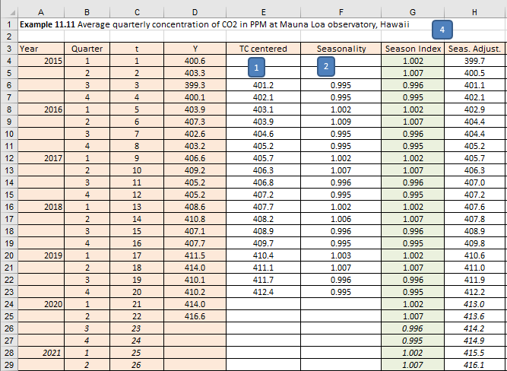
Classical decomposition combined with exponential smoothing – Example 11.11 - Excel(1/3)
The data set used are the quarterly CO₂ emissions in ppm measured at the Mauna Loa observatory in Hawaii from Q1 2015 to Q2 2020. The objective is to forecasts the next four quarters until Q2 of 2021. As we already covered most of the equations, we will go directly to Excel and implement the method. Figures 11.53 and 11.54 show the complete solution.

Slide 64
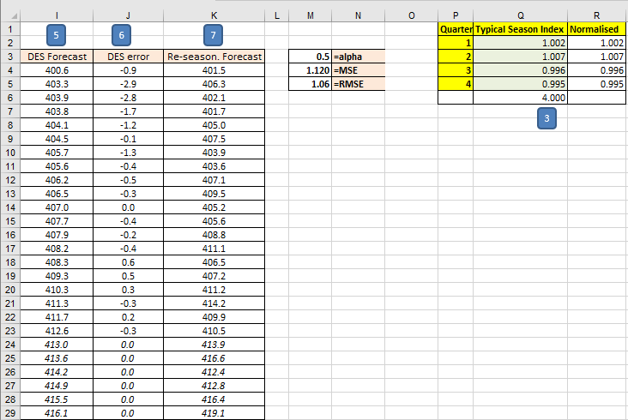
Classical decomposition combined with exponential smoothing – Example 11.11 - Excel (2/3)

Slide 65

Classical decomposition combined with exponential smoothing – Example 11.11 – Excel (3/3)
As we can see, visually we have a good fit.
Initially, the first 5 periods, our forecasts are not too good, which is the consequence of using a very short time series (only 20 observations).
For a longer time-series, this initial mismatch would become even less relevant. From Example 11.8 we know that we can optimize the forecast by changing the value of alpha. This is achieved using Excel Solver.
Figure 11.79

Slide 66
Classical decomposition combined with exponential smoothing – Example 11.11 – SPSS
SPSS does not have a “ready-made” solution that is identical to the approach we took here. However, it offers some other interesting methods, and we will show how to use them in the next section.

Slide 67
Holt-Winters seasonal exponential smoothing (1/4)
One of the most effective forecasting methods for seasonal data, based on exponential smoothing, is the Holt-Winters method. It uses three smoothing equations and three smoothing constants, but it is not as complex as it sounds. The three equations are dedicated to three different components, namely:
Level
Trend
Seasonality
Effectively we are combining the linear regression components (intercept or level, and slope) with the seasonal component. The only difference is that in the case of the Holt-Winters method, these components are dynamic.
Recall that in simple regression we had only one value of a, which is the intercept, and one value of b, which is the slope. Here, we have changing values of a_{t} and b_{t}. However, to avoid confusion, we’ll call the level as ℓ_{t}, trend as b_{t} and the seasonality component a S_{t}.

Slide 68

Holt-Winters seasonal exponential smoothing (2/4)
There is one more point to remember. Holt-Winters method comes in two “flavours”. One is the model where these components are in additive relationship and the other one is multiplicative relationship. We use additive Holt-Winters model mainly for stationary time series and multiplicative Holt-Winters model predominantly for non-stationary time series. And lastly, alpha (α), the smoothing constant, is used for the level equation. Beta (β) the smoothing constant is used for the trend equation, and gamma (γ) for the smoothing constant for the seasonal equation. Let’s show these three equations.
For the additive model, the equations are:

Slide 69


Holt-Winters seasonal exponential smoothing (3/4)
For the multiplicative model, the equations are:
The small s in the above equations is used for periodicity (for quarterly data s=4, for monthly s=12, etc.). This means that forecasts for the additive and multiplicative models are produced respectively as:
Where m is the number of forecasts ahead.

Slide 70


Holt-Winters seasonal exponential smoothing (4/4)
The values of the smoothing constants will be as follows:
The equations indicate that ℓ₀ is equal to the average value of just the first-year data. b₀ is zero and s₀ is calculated only for the first year (because here t=1, …, s) as a ratio between the individual observations and their first-year average.
To start the calculations, the initial values of ℓ_{t}, b_{t} and S_{t} are:
Note that if β = 0 and γ = 0, then the Holt-Winters model is equivalent to single exponential smoothing (SES).

Slide 71

Holt-Winters seasonal exponential smoothing – Example 11.12 - Excel (1/2)
The data set used are the quarterly CO₂ emissions in ppm measured at the Mauna Loa observatory in Hawaii from Q1 2015 to Q2 2020. The objective is to forecasts the next four quarters until Q2 of 2021. We will skip manual equations and move directly into Excel solution.
Figure 11.80 shows how the model was implemented in Excel. Note that in all three equations we used the initial value of 0.5 for all three smoothing constants. This is arbitrary. We know that the range is 0 < α ≤ 1, 0 < β ≤ 1 and 0 < γ ≤ 1-α, so 0.5 is as good as any other value in this range.

Slide 72

Holt-Winters seasonal exponential smoothing – Example 11.12 – Excel (2/2)
The formulae in Figure 11.80 are the direct implementations of all the equations from this section in the Excel format. Column E in Figure 11.80 is equation (11.26), column F equation (11.27), column G equation (11.28) and column H is equation (11.30). To check the visual appearance of our forecasts, we produce the graph in Figure 11.81.
Figure 11.81

Slide 73

Holt-Winters seasonal exponential smoothing – Example 11.13 - Excel (1/4)
In Figure 11.81 we can see more than a reasonable fit with the data set. However, we can optimise it using Excel Solver, as we did in Example 11.9. Example 11.13 demonstrates how we did the optimization here.

Slide 74
Holt-Winters seasonal exponential smoothing – Example 11.13 – Excel (2/4)
As before, we are targeting to minimise cell J6, which is the value of MSE. The objective will be achieved by changing cells J3:J5 in Figure 11.80, which are the three smoothing constants.
The constraints we used to limit changes are that both α and β should be between zero and one, whilst γ should be between 0 and 1- α.
The improvements were not so significant.
The MSE went down from 0.979 to 0.891. We set the initial value of all three smoothing constants to 0.5.
After optimisation we got: α=0.41, β=0.31 and γ=0.58.
Although not a significant drop in MSE, still we can say that we optimised our forecasts.

Slide 75

Holt-Winters seasonal exponential smoothing – Example 11.13 – Excel (3/4)
Figure 11.83 shows the optimised version of the same example.

Slide 76

Holt-Winters seasonal exponential smoothing – Example 11.13 - Excel (4/4)
As we have not changed any formulae in the spreadsheet, except optimised the values in cells J3:J7, there is no need to repeat the Excel Solution descriptions. All the cells retain the same formulae as in Example 11.12. In Figure 11.84 we show the results of the optimised forecasts in a visual form. The results are not much different, but some improvement has been achieved.
Figure 11.84

Slide 77

Holt-Winters seasonal exponential smoothing – Example 11.13 – SPSS (1/12)
The date is in year/quarters rather than in years compared to the previous examples.
Figure 11.85

Slide 78

Holt-Winters seasonal exponential smoothing – Example 11.13 – SPSS (2/12)
Select Analyze > Forecasting > Create Traditional Model
Transfer Series into Dependent Variables box
Select Method: Exponential Smoothing
Click on Criteria box.
Select Winters multiplicative model
Click Continue
Figure 11.86

Slide 79

Holt-Winters seasonal exponential smoothing – Example 11.13 – SPSS (3/12)
Figure 11.87

Slide 80

Holt-Winters seasonal exponential smoothing – Example 11.13 – SPSS (4/12)
Click on Statistics tab and choose options
Figure 11.88

Slide 81

Holt-Winters seasonal exponential smoothing – Example 11.13 – SPSS (5/12)
Click on Plots tab and select options
Figure 11.89

Slide 82

Holt-Winters seasonal exponential smoothing – Example 11.13 – SPSS (6/12)
Click on Save tab and select options
Figure 11.90

Slide 83

Holt-Winters seasonal exponential smoothing – Example 11.13 – SPSS (7/12)
Click on Options tab and select options
Click OK
Figure 11.91

Slide 84

Holt-Winters seasonal exponential smoothing – Example 11.13 – SPSS (8/12)
New variables have been created showing predicted values, lower and upper confidence levels, and the residuals, as in Figure 11.92.
Figure 11.92

Slide 85


Holt-Winters seasonal exponential smoothing – Example 11.13 – SPSS (9/12)
SPSS Output
Figure 11.93
Figure 11.94

Slide 86


Holt-Winters seasonal exponential smoothing – Example 11.13 – SPSS (10/12)
Figure 11.95
Figure 11.96

Slide 87

Holt-Winters seasonal exponential smoothing – Example 11.13 – SPSS (11/12)
And finally, the graph output is as in Figure 11.97
Figure 11.97

Slide 88
Holt-Winters seasonal exponential smoothing – Example 11.13 – SPSS (12/12)
The results are not completely identical to the ones from Excel, for a simple reason that SPSS uses a pure Winters multiplicative model and in our Excel example we used Holt-Winters multiplicative version of the model.
Nevertheless, the numbers are in close vicinity to one another.
We did not show how to calculate the prediction interval in this example, but it is identical to all the previous ones.

Slide 89
Conclusion
This presentation provided a set of tools which can be used to analyse time series data:
Time series data
Moving averages
Exponential smoothing
Handling errors
Handling seasonality using exponential smoothing

